Slide 1
SSI/SSDI Outreach, Access, and Recovery (SOAR):
A Reentry Tool for Individuals Involved in the
Criminal Justice System
Presented by the Substance Abuse and Mental Health Services Administration (SAMHSA)
SOAR Technical Assistance (TA) Center
In Partnership with the SAMHSA GAINS Center
U.S. Department of Health and Human Services
October 24, 2018

Slide 2
Disclaimer
The views, opinions, and content expressed
in this presentation do not necessarily reflect
the views, opinions, or policies of the
Center for Mental Health Services (CMHS), the Substance Abuse and Mental Health Services Administration (SAMHSA), or the U.S. Department of Health and Human Services (HHS).

Slide 3
Webinar Instructions
Muting
Recording availability
Downloading documents
Questions and Answers

Slide 4
Purpose and Objectives
Key strategies for introducing SOAR to and engaging criminal justice systems
SOAR best practices for assisting SSI/SSDI applicants who are involved in the criminal justice system

Slide 5
Agenda
SOAR and Criminal Justice System Implementation
Dazara Ware, MPC, SAMHSA SOAR TA Center, Policy Research Associates, Inc., Delmar, New York
Dan Abreu, MS CRC LMHC, SAMHSA GAINS Center, Policy Research Associates, Inc., Delmar, New York
SOAR Jail Implementation: Nashville Example
Paul J. Mulloy, Director of Programs, Nashville Sheriff’s Office, Nashville, Tennessee
Lolita Johnson, LEAD SOAR Counselor, Davidson County Sheriff’s Office, Nashville, Tennessee
SOAR Prison Implementation: Oklahoma Example
Donna Bond, Coordinator of Mental Health Reentry, Oklahoma Department of Corrections, Oklahoma City, Oklahoma
Marcus Ayers, Manager of Prison Based Reentry Services, Oklahoma Department of Mental Health Services, Oklahoma City, Oklahoma
Questions and Answers
Facilitated by the SAMHSA SOAR TA Center

Slide 6
Welcome!
Robert Grace
Public Health Advisor
Homeless Programs Branch
Center for Mental Health Services
Substance Abuse and Mental Health Services Administration
October 24, 2018

Slide 7
SOAR and the Criminal Justice System
Dazara Ware
Senior Project Associate
SAMHSA SOAR Technical Assistance Center
Policy Research Associates, Inc.
October 24, 2018

Slide 8

What is SOAR?
A model for assisting eligible individuals to apply for Supplemental Security Income (SSI) and Social Security Disability Insurance (SSDI)
For individuals who are experiencing or at-risk of homelessness and have a serious mental illness, co-occurring substance use disorder, or other physical disabilities
Sponsored by the Substance Abuse and Mental Health Services Administration (SAMHSA) in collaboration with the Social Security Administration (SSA) since 2005
All 50 states and Washington, D.C. currently participate

Slide 9
SSI and SSDI: The Basics
Supplemental Security Income (SSI)
Needs based
Federal benefit rate is $750 (2018)
Provides Medicaid in most states
Social Security Disability Insurance (SSDI)
Amount depends on earnings put into SSA system
Medicare generally provided after 2 years of eligibility

Slide 10

Receiving Benefits: Supplemental Security Income (SSI)
Incarceration Time | Effect on Benefits | Action Needed Upon Release
< 1 full calendar month | No effect | N/A
1 - 12 calendar months | Suspended | Can be reinstated upon release
12+ consecutive calendar months | Terminated | Must reapply*
*As a general rule, reapplication can be made 30 days prior to expected release date but benefits cannot begin until release. With a pre-release agreement, this time can be extended to 120 days prior to release.

Slide 11
Receiving Benefits: Social Security Disability Insurance (SSDI)
Incarceration Time | Effect on Benefits | Action Needed Upon Release
< 30 days | No effect | N/A
> 30 days* *convicted and confined | Suspended | Can be reinstated upon release
*Recipients are eligible to continue receiving their benefits until they are convicted of a criminal offense and confined to a penal institution for more than 30 continuous days.

Slide 12
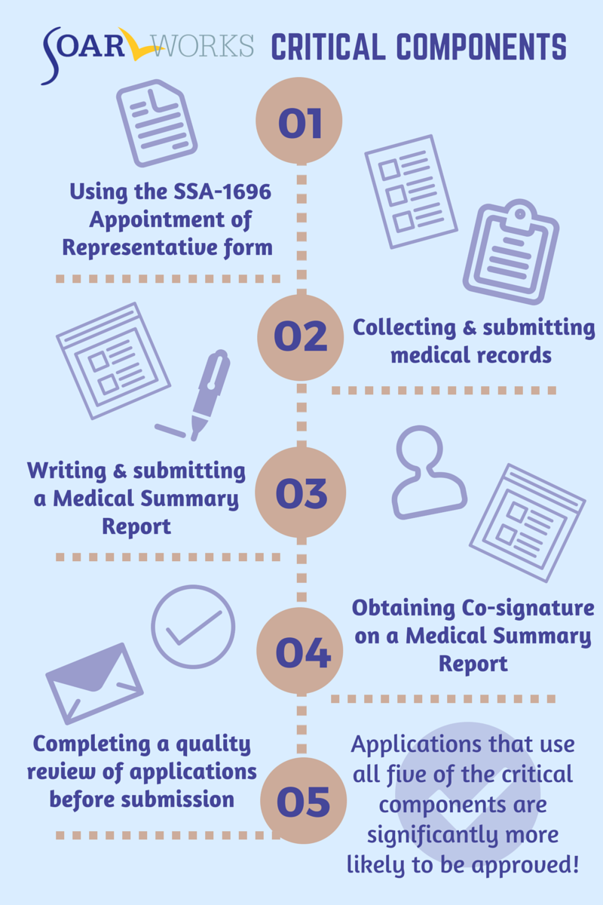

What Makes SOAR Unique?
SOAR-trained case workers are the heroes!

Slide 13
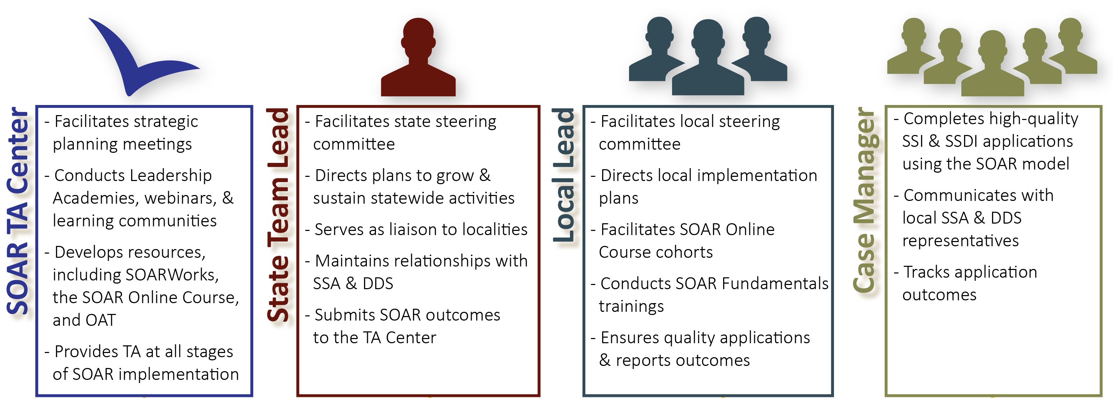
SOAR Leadership Structure
*OAT: Online Application Tracking Program
*SSA: Social Security Administration
*DDS: Disability Determination Services
*TA: Technical Assistance
Notes:
Be sure to mention that case managers might have an agency lead that uses OAT and helps supervise multiple case managers
All these players are ambassadors for SOAR Initiative – united in ending homelessness for individuals with disabling conditions

Slide 14
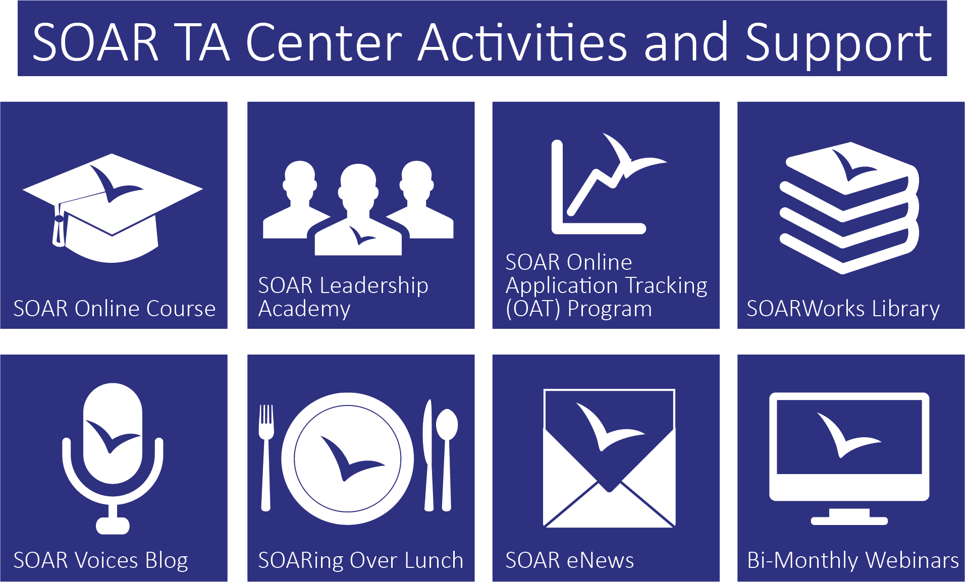
Oh, the support you will receive!

Slide 15
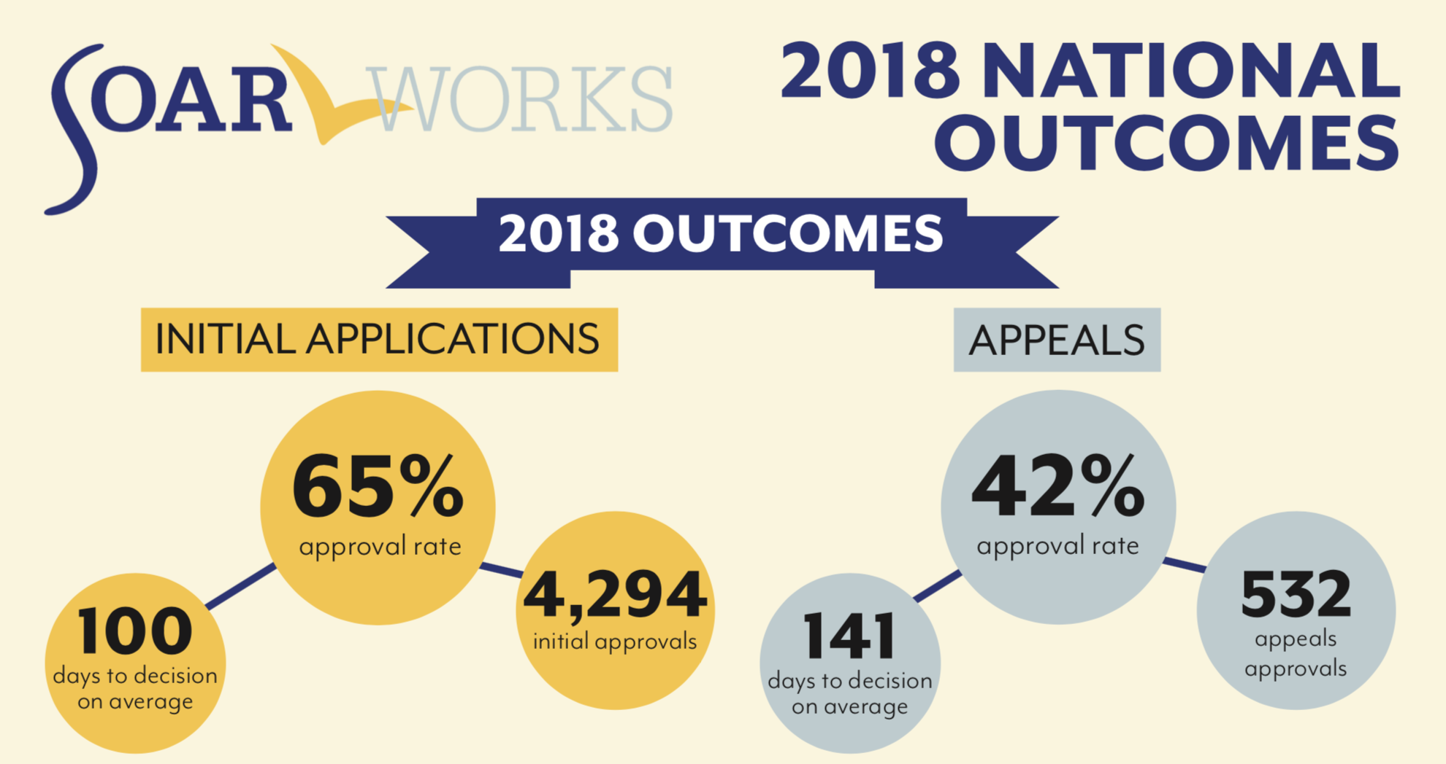
2018 National SOAR Outcomes
*As compared to a 29% approval rate for all SSI/SSDI applicants nationwide
SSI Annual Statistical Report, 2017. Table 70. SSA Pub. No. 13-11827. Washington, D.C.: SSA, September 2018

Slide 16
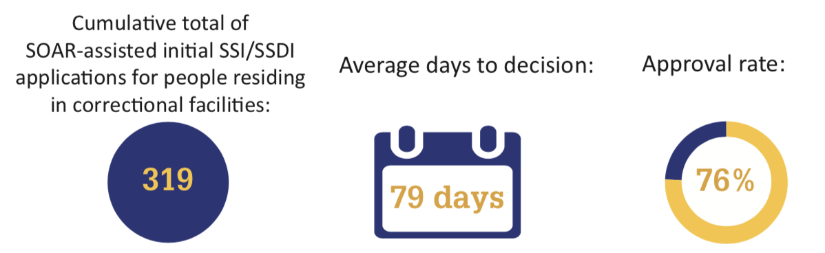
SOAR Criminal Justice Outcomes
*Data accessed from the SOAR Online Application (OAT) tracking system on August 1, 2018

Slide 17

SSI/SSDI Promotes Post Release Success
  Income: Reduces state costs
  Insurance: Healthier individuals; healthier communities
  Access to housing: Becoming a paying customer
  Integration into community
  Decrease in incarcerations and hospitalizations
17

Slide 18

Collaborations
The areas of criminal justice, behavioral health, and homelessness share the
same clientele
No single program can address
every need
Collaboration is key to successful
reentry

Slide 19
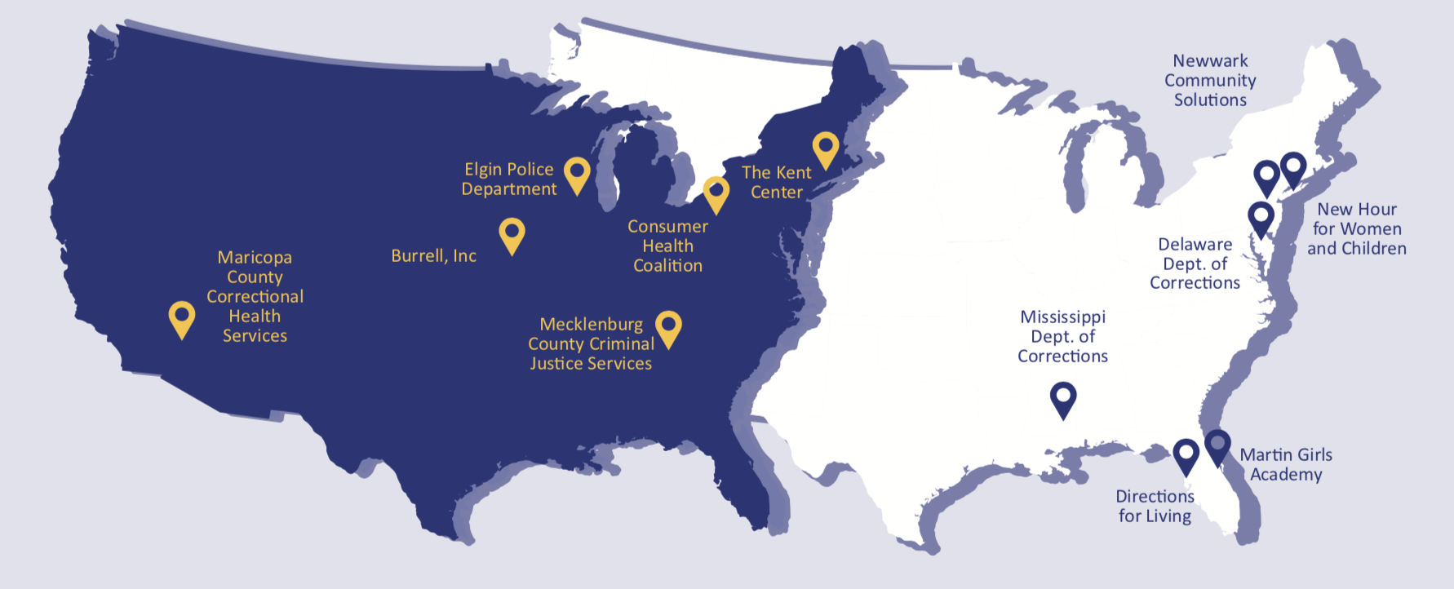
SOAR Implementation in Criminal Justice Settings

Slide 20

How to Start a SOAR Initiative in CJ Settings
Identify the need
Prepare a proposal
Use outcomes to gain leverage for funding
Work with SSA and DDS on pre-release agreement
Communicate, Collaborate, Initiate
Notes:
Communicate – Discuss what is currently being done to help offenders gain access to benefits; identify the barriers; Discuss the difficult topics (funding, resources, time)
Collaborate – Internally and outside the facility
Initiate – Start! Consider a pilot.
,

Slide 21
SOAR Implementation in Criminal Justice Settings
Dan Abreu
Senior Project Associate
SAMHSA GAINS Center
Policy Research Associates, Inc.
Substance Abuse and Mental Health Services Administration
U.S. Department of Health and Human Services
October 24, 2018

Slide 22
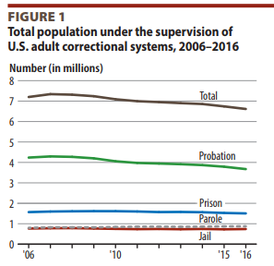
The Numbers
1.9 MILLION in jail or prison
Subramainian, R., Delaney, R., Roberts, S., Fishman, N., & McGarry, P. (2015). Incarceration's front door: The misuse of jails in America. New York: Vera Institute.
Kabele, D., & Cowhig, M. (2018). Correctional populations in the United States, 2016. Washington, DC: Bureau of Justice Statistics.

Slide 23

Medical Problems of State Prisoners
Ever had a chronic condition/disease? | State and federal prisoners | General population
Chronic Condition | 43.9 | 31
High Blood pressure | 30 | 18
Diabetes | 9 | 6.5
Heart related | 9.8 | 2.9
Infectious Disease | 21 | 4.8
Hepatitis | 10 | 1.1
Tuberculosis | 6 | .5
HIV/AIDS | 1.3 | .4
Maruschak, L.M. Berzofsky, M., Unangst, J. (2016). Medical Problems of State and Federal Prisoners and Jail Inmates, 2011–12. Washington, DC: Bureau of Justice Statistics.

Slide 24
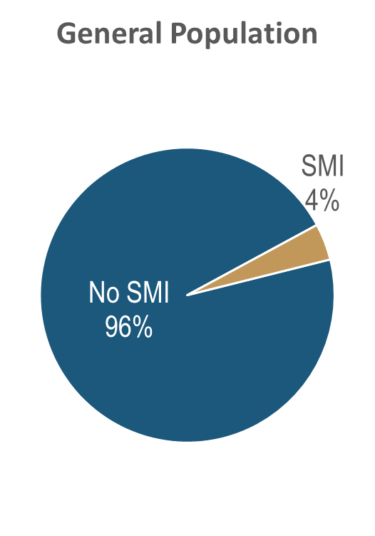
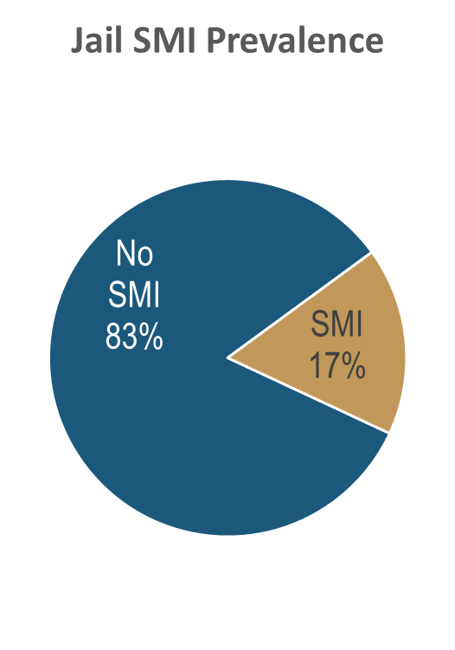
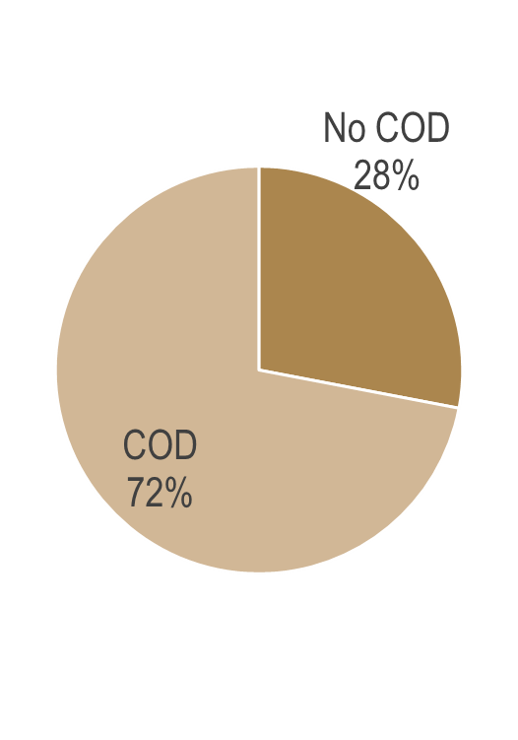
Jails and Mental Disorders
Steadman, H. J., Scott, J. E., Osher, F., et al. (2005). Validation of the Brief Jail Mental Health Screen. Psychiatric Services, 56: 816–822.
Notes:
Let’s get a better picture of the general population and individuals with mental health disorders.
What happens when we take a general prevalence rate and move it into the criminal justice system? (It goes up)…1 of every 6 people coming into the county jail are dealing with a serious mental illness (not just a mental health issue)- think about that- what if 1 in 6 were coming in with a serious medical issue (heart problems)- we would do something to address it

Slide 25
Diversion of People with Serious Mental Illness
High Rates of Physical and Sexual Abuse
Lifetime
96%
Current
74%
Lifetime
89%
Current
86%
Policy Research Associates, Inc. (2012). Evaluation of the CMHS Targeted Capacity Expansion for Jail Diversion Programs: Final Report. Delmar, NY: Author.

Slide 26
Differences with Serious Mental illness (SMI)
How are justice-involved persons with SMI different from those without SMI?
More likely to experience homelessness
More likely to have co-occurring disorders
Use a greater variety of services (higher cost)
More likely to have disciplinary problems
More likely to be unemployed
More psychological impairment (incl. extensive trauma histories) (1)
Longer Length of Stay (2)
James, D.J., Glaze, L.E. (2006). Mental Health Problems of Prison and Jail Inmates Bureau of Justice Statistics, NCJ 213600
Council of State Governments Justice Center. (2012). Improving Outcomes for People with
Mental Illnesses Involved with New York City’s Criminal Court and Correction Systems.

Slide 27
Justice Involvement Compounds Homelessness
and Vice Versa
Peterson, R. P. (2015). Arrested and homeless in NYC (Research Brief). New York: New York City Criminal Justice Agency .

Slide 28
Nature of Jails

Slide 29
Jail Health Care Models
Jail employs health care staff
Jail contracts with National Correctional Health Care Vendor
Jail contracts with local, private or public providers
County Health Department and/or jail provides jail health care

Slide 30
Reentry is a Matter of Life and Death
2007 study of 30,000 individuals released from prison in Washington State
  443 died during follow-up period of 1.9 years
  Death rate 3.5 times higher than general population
  Death rate for inmates with SMI 12.7 times higher in the 14 days following release
  Primary causes of death
    Drug overdose, heart disease, homicide, and suicide
Binswanger, I. A., Stern, M. F., Deyo, R. A., Heagerty, P. J., Cheadle, A., Elmore, J. G., & Koepsell, T. D. (2007). Release from Prison — A High Risk of Death for Former Inmates. The New England Journal of Medicine, 356(2), 157–165.

Slide 31
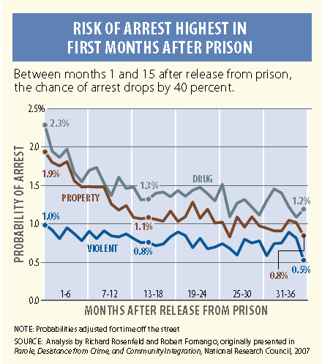
Transition Services Critical

Slide 32
SOAR Driven Reentry
Income
Health care
Access to Housing
Notes:
Dan – I left this slide as a reminder to the audience. I took out some text because it is included in slide 14. DW

Slide 33
Challenges to SOAR implementation in CJ Settings
Leadership
Collaboration
Resources
Competing Initiatives
Training
Notes:
Dan I switched slides 31` and 32 to end with solutions (not challenges). When discussing challenges, can you address the challenges specific to jails vs prisons? DW

Slide 34
SOAR and Jail Implementation:
Nashville Example
Paul J. Mulloy, Director of Programs
Nashville Sheriff’s Office, Nashville, Tennessee
Lolita Johnson, LEAD SOAR Counselor
Davidson County Sheriff Office, Nashville, Tennessee
October 24, 2018

Slide 35
SOAR and Criminal Justice Collaboration
SOAR DCSO (Sheriff’s Office)
Collaboration through the Mayor’s Office of Innovation, Sheriff’s Office, Metro Social Services, etc.
Initiative within the Jail was established July 2014
Sole mission of SOAR at DCSO:
  Assist incarcerated individuals with a severe and persistent mental illness who are without income and/or experiencing homelessness to re-enter into society

Slide 36
DCSO SOAR Eligibility Criteria
Individuals are not currently in application process or pending application with the Social Security Administration (SSA)
Pre-Release Agreement: Must be within 120 days of being released from jail
Have experienced homelessness or will experience homelessness upon their release
Diagnosed with a Severe and Persistent Mental Illness, i.e., Schizophrenia, Bipolar Disorder, etc.
Currently being treated by a Psychiatrist in the Jail and taking medications for mental health condition
Not currently working or lost job due to mental health/medical conditions
Exhibits severe functional limitations due to mental health/medical symptoms that impact their ability to complete daily activities or sustain work at substantial and gainful levels

Slide 37
Technology
ERMA (Electronic Records Management Assessment)
Keep up with assessment done on the individual as well as all records collected
Contains all progress notes from the jail doctors, as well as psychiatrists
JMS (Jail Management System)
Referrals will be made and keeping up with the individuals movements and out dates
Time line to show how long it took from starting SOAR process to approval and release

Slide 38
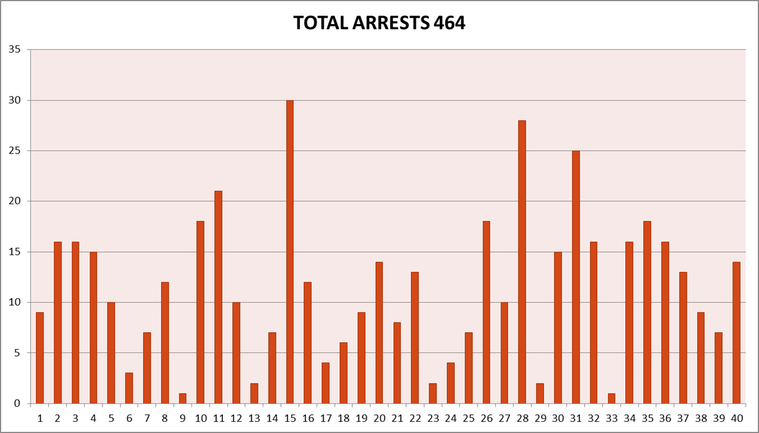
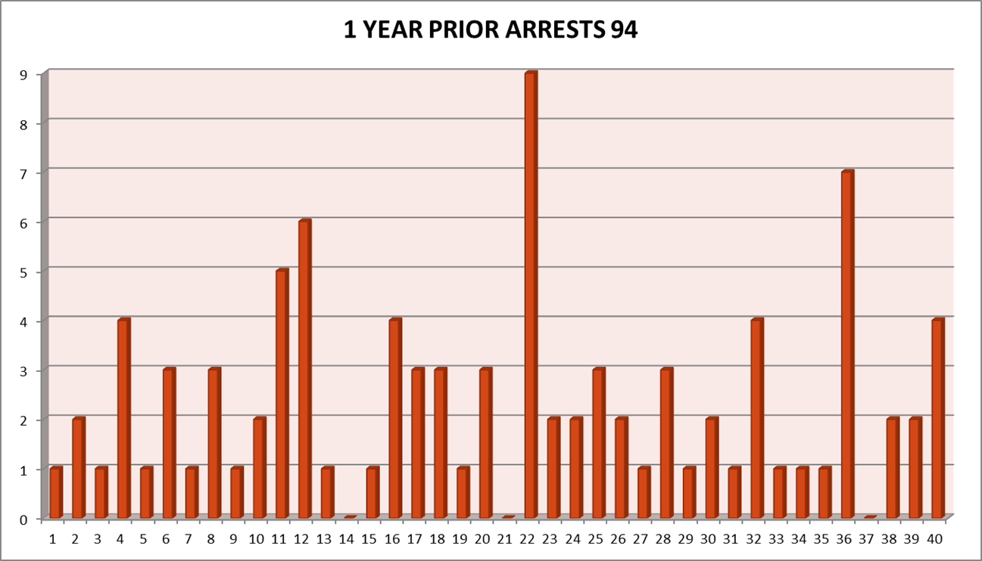
SOAR Program: Arrests Impact
SOAR Program: Total Arrests
SOAR Program: 1 Year Prior Arrests

Slide 39
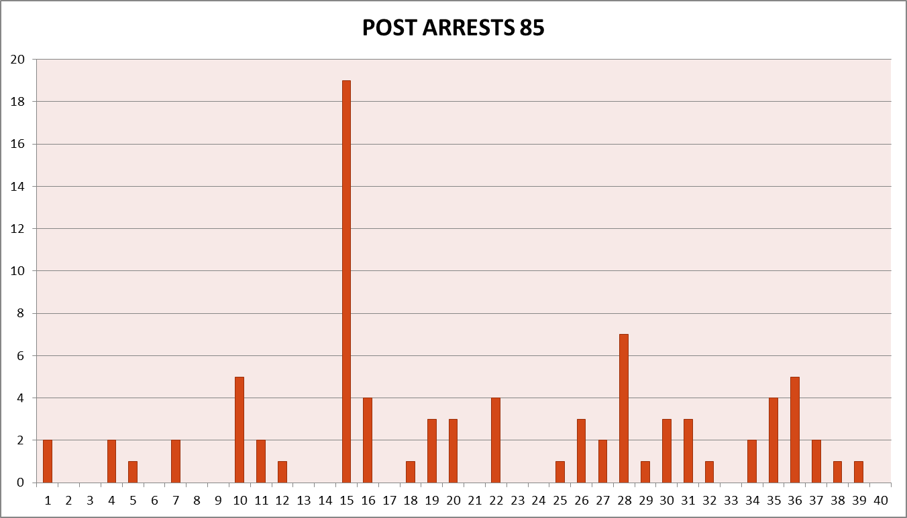
Post Arrests January 2015 - February 2017

Slide 40
SOAR and Prison Implementation:
Oklahoma Example
Donna Bond, Coordinator of Mental Health Reentry,
Oklahoma Department of Corrections
Oklahoma City, Oklahoma
Marcus Ayers, Manager of Prison Based Reentry Services,
Oklahoma Department of Mental Health Services,
Oklahoma City, Oklahoma
October 24, 2018

Slide 41
SOAR and Prison Collaboration: The Beginning
2006: Initial planning started
2007: Services and public benefit enrollments pre-approval started
Initially started with 3 Integrated Services Discharge Managers in the prison mental health units
Notes:
The collaborative efforts to get to where we are now with the success, outcomes and approval rates require ongoing collaboration, communication and a team approach

Slide 42
SOAR and Prison Collaboration: Growth Years
Since 2007…
Increased number of staff trained assist with accessing public benefits, e.g.) SSI/SSDI
Built and nurtured relationships with various state and federal partners
  Held regular meetings with all stakeholders
Collaboration on 4 federal re-entry grants
  These grants target people with co-occurring disorders
  Also includes applying for public benefits when applicable
Notes:
In addition to our original program for the most seriously mentally ill funded by the ODMHSAS inside DOC Prisons, between the ODOC and the ODMHSAS, we’ve collaborated on 4 federal re-entry grants

Slide 43
SOAR Process In Action: Timing is Critical!
The goal: Approval before release!
Applications submitted over 120 days remaining for the inmate to serve, it is not a valid application and a new one must be done
Having too little time to complete the entire process can create many post release obstacles
Notes:
Stress the importance of following the established time frames to get approval prior to release
If an application is submitted over 120 days remaining for the inmate to serve, it is not a valid application and a new one must be done
Having too little time and not getting the entire process done with a pre-approval can create many obstacles post release as well
Timing is critical!

Slide 44
SOAR Process: Quality Counts!
Establish a SOAR Process
  Once the online application is done with accurate, clear information, records are faxed to the local office closest to the prison facilities
Functional information is key
  Medical Summary Report!
Celebrate process fidelity
  ODOC Psychologists receive accolades in our annual multi-agency meeting with the Disability Determination Division Examiners and local SSA Managers on the quality of the psychological documentation
Notes:
Once the online application is done with accurate, clear information, records are faxed to the local office closest to the prison facilities
After the online application, the most important document to send with the records is the psych summary
The Psychologists at ODOC who prepare reports receive accolades in our annual multi-agency meeting with the Disability Determination Division Examiners and local SSA Managers on the quality of the psychological documentation

Slide 45
SOAR Process: A Win-Win!
Following the SOAR model
Allowing time to complete and submit the applications within the correct time frame
Ensuring quality applications complete with the Medical Summary Report
We’ve had approvals as quickly as 7 days from submission to approval!
Yields Success!
Notes:
When all steps are followed, and
The SOAR application submitted within the correct time frame, and,
The online application is complete and accurate with the psych summary submitted to the local office at the same time,
We’ve had approvals as quickly as 7 days from submission to approval!

Slide 46

SOAR: Oklahoma Department of Corrections
Over the past 11 years, the approval rate has been above 80%.
Currently, 80% approval rate!!
Notes:
Currently the last report on approval rate is 80%.
Over the past 11 years, the approval rate has been above 90%.

Slide 47
How did we get here?
SOAR trained reentry staff
Mentoring
On-site supplemental training
Process consistency
Continued staff support to promote confidence with this process before they do them on their own
Notes:
Each of our reentry staff that prepare and submit public benefit applications have been to the SOAR training.
Furthermore, mentoring and on-site training is done within the reentry staff to ensure consistent practices and each staff member is comfortable with this process before they do them on their own.

Slide 48
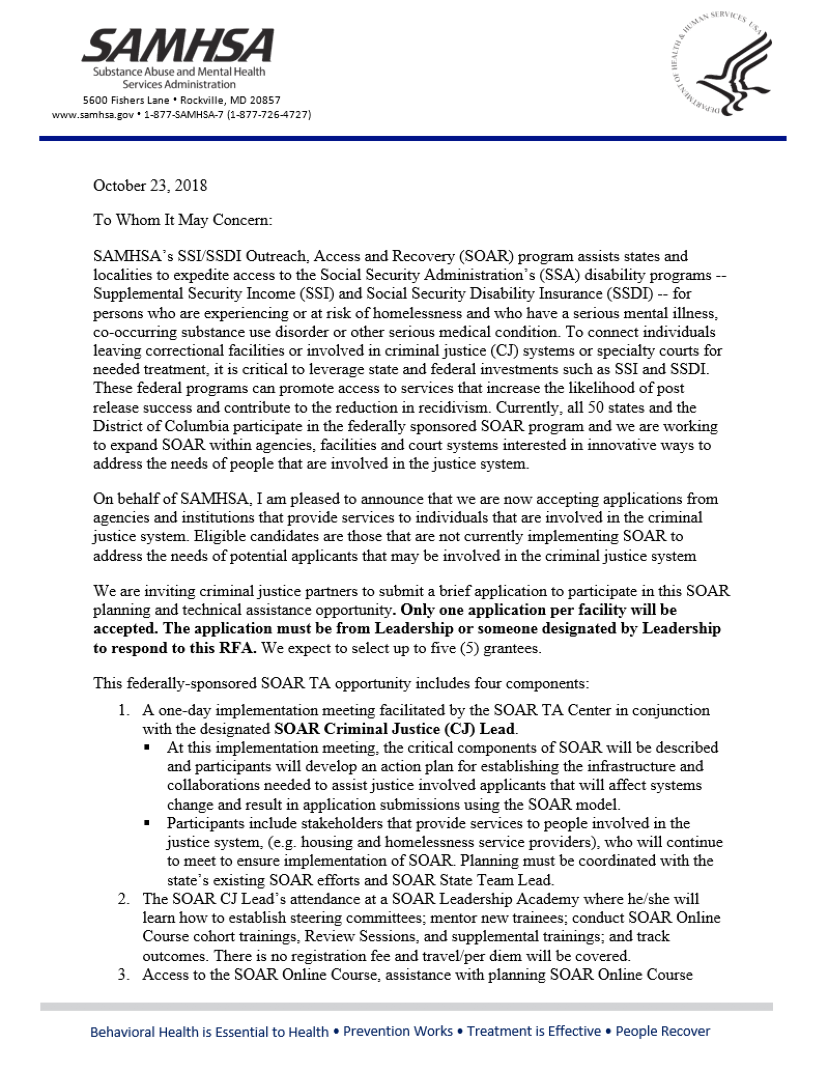
SOAR CJ Technical Assistance Opportunity
Planning and technical assistance opportunity
  Implementation meeting
  Leadership Academy participation
  SOAR Online Course and OAT
3-5 page application
Kick off call for application questions: November 14
Applications due: December 21

Slide 49
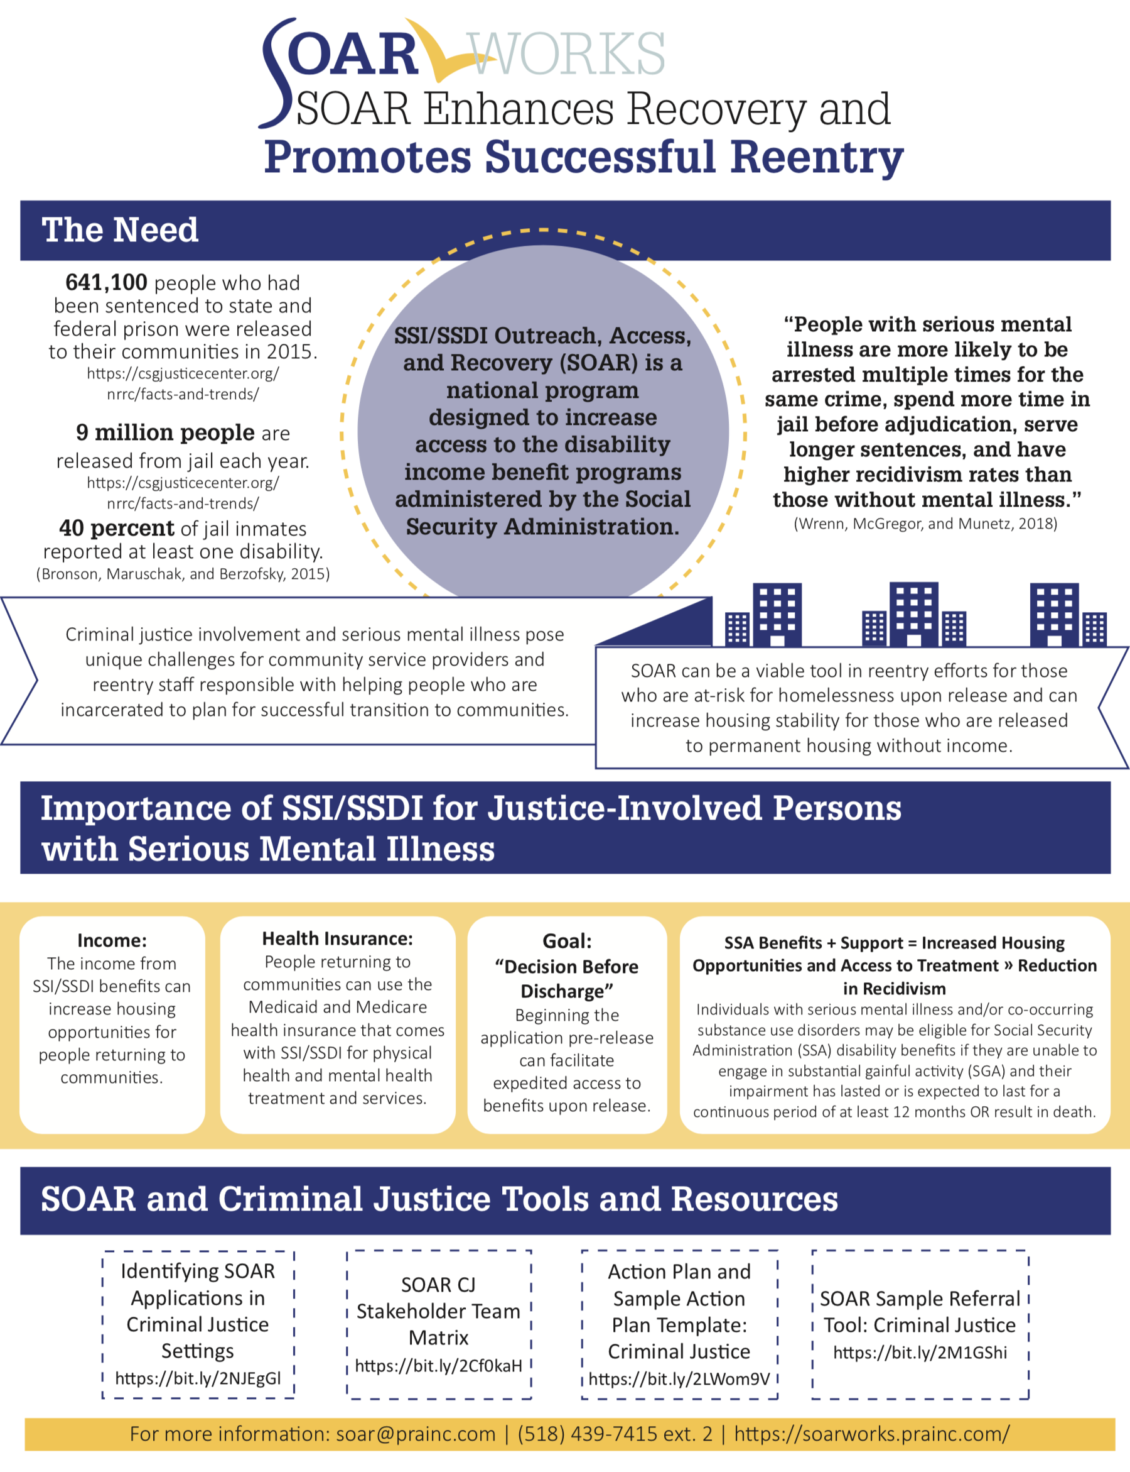
SOAR and Criminal Justice Resources
https://soarworks.prainc.com/topics/criminal-justice
Infographic
FAQs
Sample tools
Issue Brief

Slide 50
Questions and Answers
Please type your questions into the Q&A box on the right of your screen.

Slide 51
Thank You
Dazara Ware, Senior Project Associate
SAMHSA SOAR Technical Assistance Center
Subject Matter Expert on SOAR Implementation in Criminal Justice Settings
SAMHSA SOAR TA Center
dware@prainc.com

