Slide 1
Welcome! The Webinar will Begin Shortly
Technical Assistance FAQs
1. Why can’t I hear anything?
To hear audio, use your phone to call toll-free: 1-855-749-4750
Enter Access code: 663 188 223
Enter Unique Attendee ID#: This can be found under the “Event Info” tab on WebEx screen
There is NO hold music, so you will not hear anything until the webinar begins.
2. How do I access the slides/materials?
Download from our website https://soarworks.prainc.com/ (Click ‘Webinars’ on left-hand side)
Or, at top left of this screen, click File: Save: Document
3. Will this webinar be recorded?
YES, and it will be posted on our website within 1 week.
For further assistance, please call 518-439-7415 x5242 or email lguerin@prainc.com.

Slide 2
Understanding Opioids and Other Drugs: How Usage Impacts SOAR Applications
Presented BY:
SAMHSA SOAR Technical Assistance Center
Policy Research Associates, Inc.
Under Contract TO:
Substance Abuse and Mental Health Services Administration
U.S. Department of Health and Human Services

Slide 3
Welcome!
Robert Grace, SOAR Project Officer, Homeless Programs Branch, Center for Mental Health Services, Rockville, MD

Slide 4
Disclaimer
This training is supported by the Substance Abuse and Mental Health Services Administration (SAMHSA) and the U.S. Department of Health and Human Services (DHHS)
The contents of this presentation do not necessarily reflect the views or policies of SAMHSA or DHHS.
The training should not be considered substitutes for individualized care and treatment decisions.

Slide 5
Webinar Instructions
Muting
Recording availability
Downloading documents
Evaluation
Question instructions

Slide 6
Learning Objectives
Understand opioid abuse and misuse amongst people experiencing homelessness
Understand the clinical consequences of addiction to opioids and difference between prescribed treatment and addiction
Learn about the opioid crisis in eastern Kentucky and Maryland and the treatment options and supportive services available
Understand the importance of peer supports with engaging and providing service to individuals with opioid use and misuse
Improve your knowledge of the signs of opioid addiction and related treatments and services to better serve SOAR applicants

Slide 7
Agenda
Clinical Introduction: Opioid Abuse Amongst People Experiencing Homelessness
Dr. Tyler Gray, M.D., Medical Director, Healthcare for the Homeless, West Baltimore, Maryland
Opioids and Housing in Eastern Kentucky
Jacqueline Long, Housing Director, Mountain Comprehensive Center, Prestonsburg, Kentucky
Medication Assisted Treatment: A Peers Perspective
Steven Samra, MPA, SAMHSA’s BRSS TACS, Needham, Massachusetts
Questions & Answers
Facilitated by SOAR TA Center Staff

Slide 8
Clinical Introduction: Opioid Abuse Amongst People Experiencing Homelessness
TYLER GRAY, MD
Medical Director
HEALTHCARE FOR THE HOMELESS, West BALTIMORE, Maryland

Slide 9
Disclaimer
I am a family physician in primary care with an interest in addiction
I am not specialty trained in addiction
I have no financial disclosures

Slide 10
Presentation Outline
Case Study
Statistics
Definitions
Overview of Medication Assisted Treatment (MAT)
Treatment Strategies

Slide 11
Case Study
FJ is a 42 year old woman with AIDS, hepatitis C and major depression who asks for help for her heroin and cocaine problem.
She decides to start on Suboxone (buprenorphine) treatment with visits every 1-2 weeks She reports goes to NA a few times each week and lives “here and there” or with her parents
She frequently misses appointments then comes in within a few days, and her urine is always positive for heroin and cocaine
She isn’t consistent with taking her HIV medication
She agrees to enter a drug treatment program and is escorted by the outreach worker to 2 different programs, leaving each within a couple weeks after failing to follow the rules

Slide 12
Maryland Statistics

Slide 13
Maryland Statistics Cont.

Slide 14
Maryland Statistics Cont.

Slide 15
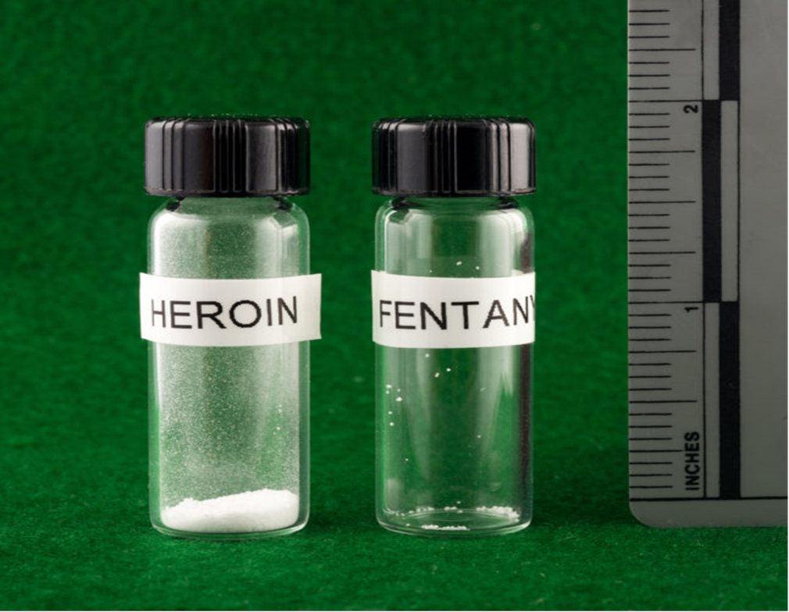
Why Fentanyl is deadlier than Heroin in a single photo
http://www.statnews.com/

Slide 16
Definitions
Tolerance: The body gets used to a certain dose of a substance
Withdrawal: Symptoms caused when habitual use suddenly stops
Dependence: Being physically “dependent” on a substance [Note: not used in DSM V]
Addiction: See next slide [Note: not used in DSM V]

Slide 17
Definition of Substance Use Disorder
Diagnostic and Statistical Manual (DSM) V:
1 More and longer use
2. Unable to quit
3. Lots of time spent
4. Cravings
5. Failure to meet obligations
6. Use despite recurrent social/interpersonal problems
7. Less pro-social activities
8. Use in hazardous situations
9. Use despite physical or mental health sequelae
10. Tolerance
11. Withdrawal symptoms
Need 2 criteria:
Mild= 2-3
Moderate= 4-5
Severe= 6+

Slide 18
Co-Occurring Disorders
Definition: The co-existence of both a serious mental illness and a substance use disorder.
“ In many cases, people receive treatment for one disorder while the other disorder remains untreated. This may occur because both mental and substance use disorders can have biological, psychological and social components.”
www.samhsa/disorders/co-occuring

Slide 19
Signs of Opioid Use Disorder (OUD)
Intoxication | Withdrawal: “Dope sick”
Somnolence | Anxiety
Pinpoint pupils | Restlessness
Slow breathing | Dilated pupils
Nausea/vomiting | Nausea/vomiting/diarrhea
Confusion | Goosebumps
 | Runny nose, tearing eyes
(Note: Track marks, skin infections) | Pain “all over”

Slide 20
Your Brain on Drugs
Dopamine! The brain never forgets that first high...
Tolerance and withdrawal develop
Compulsive use- avoid withdrawal, seek dopamine
Stress, compulsive behavior, and the social context of initial use can lead to relapse after years without opioids!

Slide 21
Consequences of OUD
Infections
HIV
Hepatitis C
Hepatitis B
Bacterial- skin and systemic
Medical Consequences
Heart failure
Stroke
Overdose
Social
Incarceration
Economic collapse
Unemployment
Loss of family support

Slide 22
What Does Treatment Entail?
Self-help groups (NA/AA, LifeRing)
Psychological interventions
Motivational interviewing/motivational enhancement therapy (MET)
Cognitive behavioral therapy (CBT)
Community interventions
Community reinforcement approach
Medically supervised detox
Medication assisted treatment (MAT)
Methadone
Buprenorphine
Naltrexone
Intensive outpatient treatment (IOP)
Inpatient/residential

Slide 23
Medication Chart- Opioids
Medication | Action | Use
Methadone | Full opioid agonist | Opioid replacement
Buprenorphine | Partial opioid agonist | Opioid replacement
Naloxone (Narcan) | Opioid blocker | Overdose reversal (effect lasts <30 min)
Naltrexone (vivitrol) | Opioid blocker | Daily/monthly opioid blockade
Notes:
Buprenorphine/naloxone combination= Suboxone
= Zubsolv, = Bunavail

Slide 24
What are the Goals of Methadone/Buprenorphine Treatment?
Reduce the harm of illicit opioid use
Relapse and overdose prevention
It IS continuing the body’s dependence on opioids (this is why it works!)
It is NOT trading one addiction for another!

Slide 25
NIDA: Principles of Drug Addiction Treatment
“Detoxification alone does not address the psychological, social, and behavioral problems associated with addiction, and therefore; does not typically produce lasting behavioral changes necessary for recovery, assessment and referral to drug addiction treatment.”

Slide 26
HCH Clinicians Network Adapted Clinical Guidelines
“Work with difficult behaviors rather than prohibiting them.”
“Practice radical inclusion of all clients…”
“Balance overall benefits of continuing MAT with potential harms.”
“Most aspects of addiction treatment are more difficult without stable housing.”
“Substance use declines when people become housed.”
“Housing should be a component of any treatment strategy to manage opioid use disorder.”

Slide 27
References
Alford, et al. 2007, Society of General Internal Medicine 2007; 22:171-76.
American Psychiatric Association (2013) Diagnostic and Statistical Manual of Mental Disorders (5th ed)
Drug and alcohol related intoxication deaths in Maryland, 2016. Maryland Department of Health, June 2017.
Meges, et al. Adapting your practice: Recommendations for the care of homeless patients with opioid use disorders. March 2014. www.nhchc.org
NHCHC policy brief on Medication Assisted Treatment, May 2016.
www.drugabuse.gov

Slide 28
Opioids and Housing in Eastern Kentucky
Jacqueline S. Long
Director of Housing and Grants
Mountain Comprehensive Care Center

Slide 29
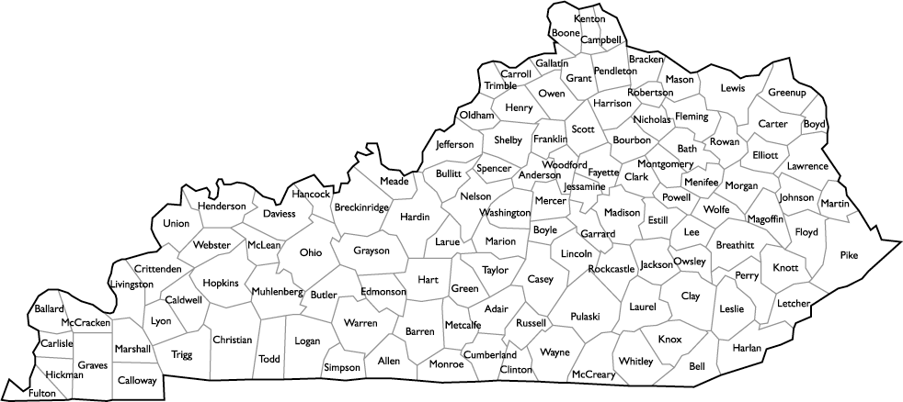
Big Sandy Region
Mountain Comprehensive Care Center is a Community Mental Health Center serving the 5 Big Sandy counties as well as many expansion sites across the state.
Yellow – Big Sandy Region Red Dots – MCCC expansion counties

Slide 30
Opioids in Big Sandy Region
Prescription opioids are the overwhelming “drug of choice” in the Big Sandy region
Some credit Medicaid expansion with making prescription opioids more available
Over prescribing remains a problem
2016 Kentucky Department of Drug Control Policy Overdose Fatality Report
Kentucky resident drug overdose death for Floyd County 2012-2016 – 46.67 deaths per 100,000 (some counties in eastern KY have death rates 3 times the national average)
Zero heroin deaths in Floyd County (Heroin and Fentanyl are a serious problem in other regions)
Gabapentin has become one of the most abused substances in the state (along with Fentanyl)
Recent complaint of resident selling Gabapentin in our housing

Slide 31
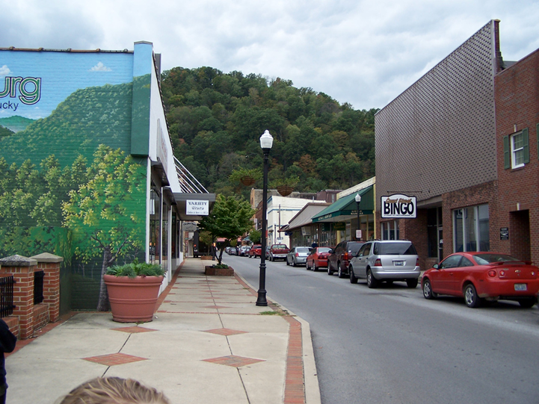
Effects of Opioid Use in Big Sandy Region
Effects of the drug epidemic are largely invisible in Prestonsburg, however it has devastated families and continues to impact economic development.

Slide 32
Effects of Opioid Use in Big Sandy Region

Slide 33
Effects of Opioid Use in Big Sandy Region
Wheelwright, Kentucky was created as a coal camp. Once a booming town, it is now a shadow of its former self and the drug epidemic is very evident in the town.

Slide 34
Effects of Opioid Use in Big Sandy Region
Increase in petty crime
Over crowded jails (taxes the infrastructure of small towns)
Broken families
Increase in domestic violence
Increase in homelessness
Children removed from homes
Strain on economic development
In need of sober workforce
Shortage of treatment beds has been addressed in the Big Sandy Area Development District Strategic Plan

Slide 35
How is MCCC Addressing the Problem?
Residential Treatment
Mountain Center for Recovery and Hope – 60 beds for men and women
Serenity House – 10 beds for treatment of women who are pregnant
Homeless Veterans Transitional Housing Center is licensed for treatment
Paducah Women’s Treatment – Under development
Outpatient Treatment
Collaboration with Drug Courts
School based programming
Funding through state resources
Housing, PATH
Grant programs
ACF Responsible Fatherhood
SAMHSA Adult Offender Reentry
SAMHSA Residential Treatment for Pregnant and Post-Partum Women
HRSA Substance abuse and Mental Health Services and Treatment (@Healthcare for the Homeless Clinic)
SAMHSA Primary and Behavioral Healthcare Integration (also at HcH Clinic)

Slide 36
Addressing the Housing Problem
Sober housing is essential to recovery
Transitional Housing
Limited construction resources
Federal Home Loan Bank
State Housing Agency
CoC Permanent Housing Bonus
HOME
Private foundations
Rental Assistance
Housing Choice Vouchers
Continuum of Care Permanent Supportive Housing
Vouchers and Operations Grants
Make commitment to Housing First
Provide in-home services
Medicaid (for co-occurring disorder)
CoC PSH Supportive Services Only grants
Start dialogue with local PHAs
Innovation – Local RFP

Slide 37
Increase Income While in Transitional Housing
To ensure success in maintaining housing, the individual’s ability to earn must be increased
Address educational gaps
Access local training resources – Workforce Innovation and Opportunity Act
Supported Employment Programs
Work with individuals to improve soft skills
Access resume writing and job search services at American Job Centers (Including Job Clubs)
For qualified individuals use SOAR to apply for SSI/SSDI benefits
Collaborate with community employers
Be innovative! Create opportunities for job training and skills building, e.g. open a coffee shop

Slide 38
Medication Assisted Treatment: A Peer Perspective
Steven K. Samra, MPA, Deputy Director
SAMHSA BRSS TACS
Needham, Massachusetts

Slide 39
One-Size Does Not Fit All Substance Use Disorders
SUDs involve the complex interaction of multiple, individual-specific factors including a person’s inherent biology as well as their environment, experience, and age
We are all unique!

Slide 40
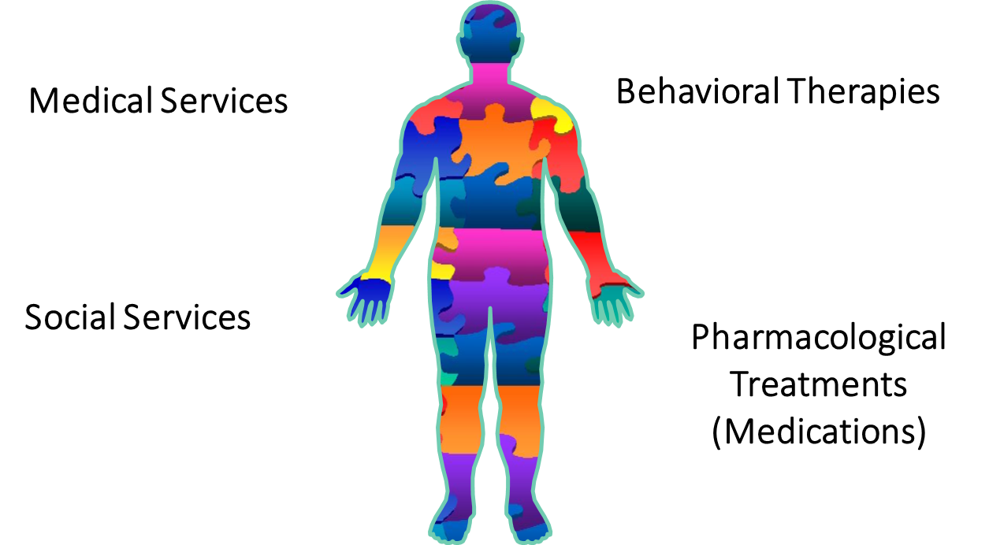
Evidenced Based Practice: Recovery Oriented Systems of Care
Treating the
Whole
Person in
their Social
Context!

Slide 41
Treatment Options
12-Step Programs: Narcotics Anonymous, Alcoholics Anonymous (NA/AA), etc. https://www.ncbi.nlm.nih.gov/pmc/articles/PMC3753023/
Medication Assisted Treatment: http://archive.samhsa.gov/MAT-Decisions-in-Recovery/
Recovery Residences: A broad term describing a sober, safe, and healthy living environment that promotes recovery from alcohol and other drug use and associated problems http://narronline.org/wp-content/uploads/2014/06/Primer-on-Recovery-Residences-09-20-2012a.pdf
Harm Reduction: A set of practical strategies and ideas aimed at reducing negative consequences associated with drug use. Harm Reduction is also a movement for social justice built on a belief in, and respect for, the rights of people who use drugs http://harmreduction.org/about-us/principles-of-harm-reduction/

Slide 42
12-Step Programs
Open to anyone
Many options to attend groups
Abstinence-based but increasingly accepting of “multiple pathways” to recovery and Medication Assisted Treatment
Viable recovery pathway for many
May inadvertently promote discrimination for those unsuccessful in AA/NA (“moral failing” rather than “disease of addiction”)
Still an important recovery resource for individuals & communities

Slide 43
Medication Assisted Treatment (MAT)
Critical, evidence-based treatment resource at height of opioid epidemic, 2017
Abstinence Rate Exceeds 60 Percent in Long-Term Follow-Up of Medication Assisted Treatment https://www.drugabuse.gov/news-events/nida-notes/2015/11/long-term-follow-up-medication-assisted-treatment-addiction-to-pain-relievers-yields-cause-optimism
Three medications available: methadone, buprenorphine, Naltrexone

Slide 44
MAT Medication Options
For more information, see SAMHSA’s online Decisions in Recovery tool available here: http://archive.samhsa.gov/MAT-Decisions-in-Recovery/section/whether.aspx

Slide 45
Recovery Residences
The purpose of a recovery residence is to provide a safe and healthy living environment to initiate and sustain recovery—defined as abstinence from alcohol and other non-prescribed drug use and improvement in one’s physical, mental, spiritual, and social wellbeing.
Recovery residences are divided into Levels of Support based on the type as well as the intensity and duration of support that they offer. Services provided span from peer to-peer recovery support (all recovery residences) to medical and counseling services (recovery residences offering higher levels of support).
http://narronline.org/wp-content/uploads/2014/06/Primer-on-Recovery-Residences-09-20-2012a.pdf

Slide 46
Harm Reduction
A philosophy and set of strategies that reduce the negative consequences of harmful behavior
Harm reduction strategies target individuals, environments and policies in an effort to protect the health and safety of individuals and communities

Slide 47
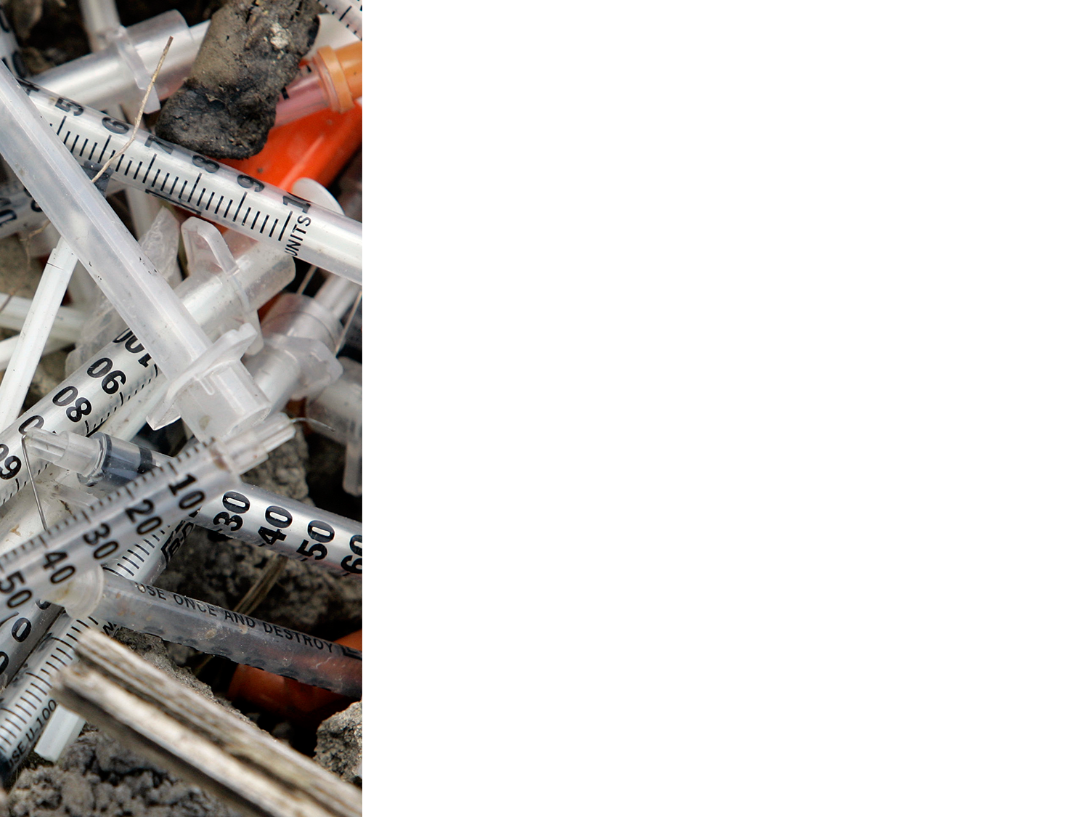
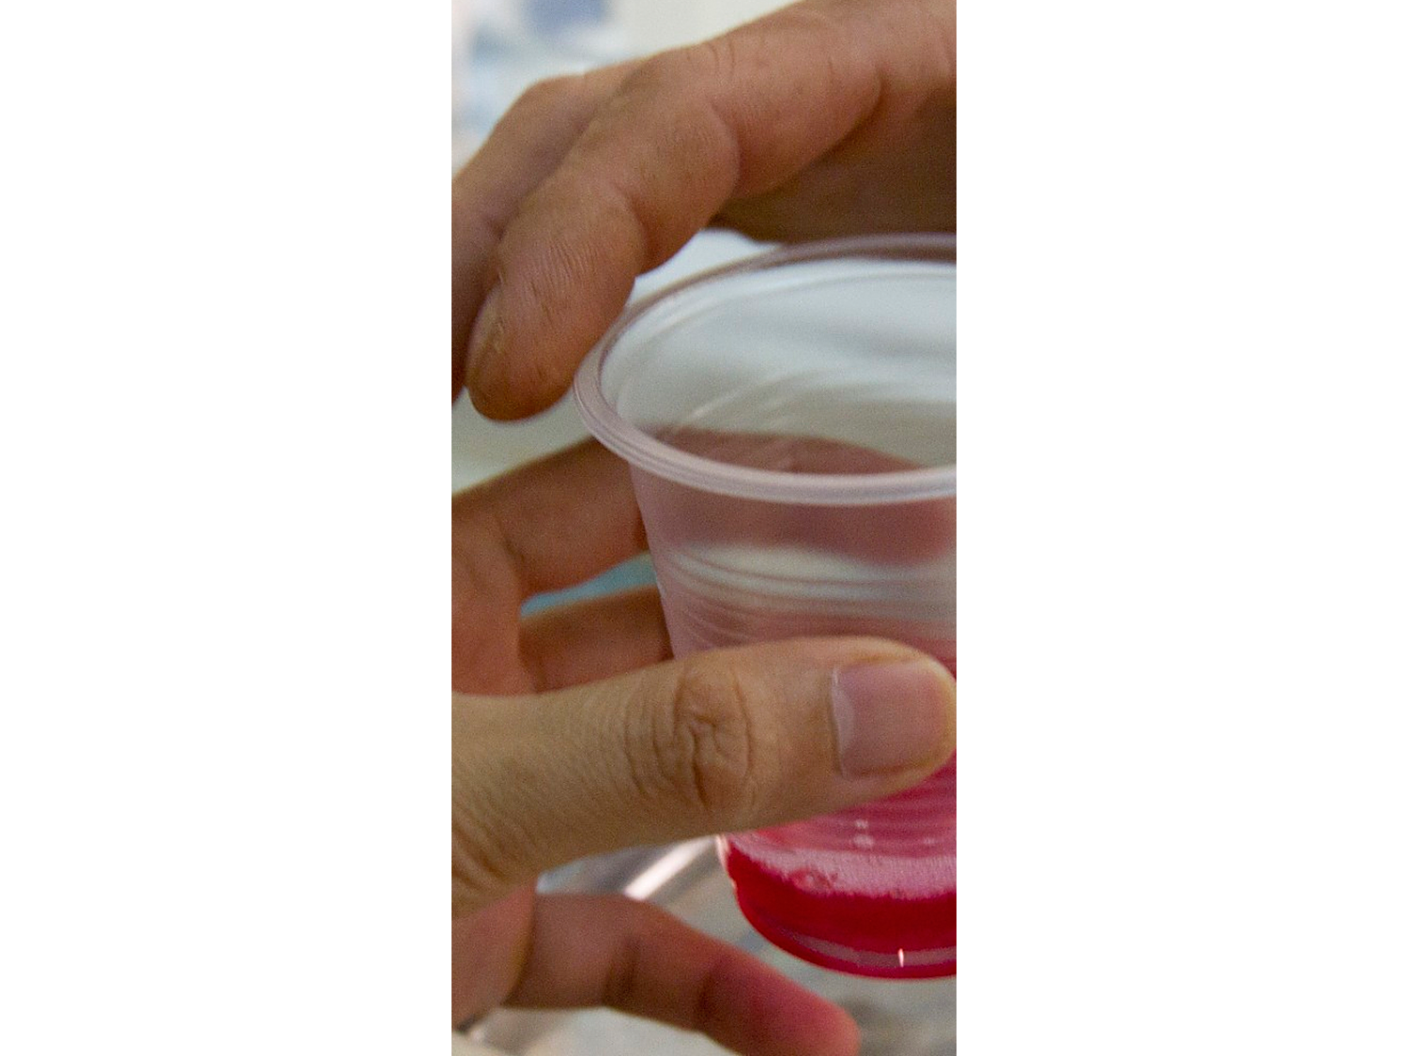
Harm Reduction Examples
INDIVIDUALS
Provide clean needles
ENVIRONMENT
Accessible Methadone clinic
POLICY
“Good Samaritan” laws

Slide 48
Peer Support
Peer support services are delivered by individuals who have common life experiences with the people they are serving
Research has shown that peer support facilitates recovery and reduces health care costs
Another critical component that peers provide is the development of self-efficacy through role modeling and assisting peers with ongoing recovery through mastery of experiences
https://www.samhsa.gov/recovery/peer-support-social-inclusion
Notes:
People with mental and/or substance use disorders have a unique capacity to help each other based on a shared affiliation and a deep understanding of this experience. In self-help and mutual support, people offer this support, strength, and hope to their peers, which allows for personal growth, wellness promotion, and recovery.
Peers also provide assistance that promotes a sense of belonging within the community. The ability to contribute to and enjoy one’s community is key to recovery and well-being.

Slide 49
Why Does This Matter For SOAR Providers?
Helps us look beyond the “deficit” (what’s wrong with you) and recognize the importance of income, insurance, and Peers in supporting the “whole person”
Identifies both the issue(s) for SOAR filing AND provides framework for ancillary recovery support for the individual upon receipt of new benefits
Insurance allows access to treatment for host of challenges and issues related and unrelated to drug use, but all related to a satisfying and productive life in the community
Income provides funding for housing/recovery residences and critical resources (transportation, food, medications, health needs, dental care, etc.)
Peers help support wellness and recovery via their own lived experience and modeling
A powerful recovery force for those still struggling in active addiction and gateway between clinician and client

Slide 50
It’s Personal For Me…
Long-term heroin and cocaine use (30 years)
15 years in a MAT program
Discrimination from 12-step program in 1990s delayed my entry to MAT by 3 years and 3 overdoses
Harm reduction provided clean syringes, info on drug interactions (benzos & opioids, “speedballs” etc.), MAT program in my community
ROSC approach focused on whole health wellness when I was still focused on substance misuse
Peer support made detox possible and supported me through 2 years of Post Acute Withdrawal Syndrome (PAWS)
Achieved Bachelor’s, Master’s while on MAT and practicing holistic wellness approaches
Today: longest job, longest relationship, reunification with family, own home, healthy: finally, at 58, a satisfying life in my community!
Never give up on any of us. Recovery should be expected and SOAR can be a major stepping stone along the recovery pathway. SOAR can be the key in setting up the opportunity to pursue many other options leading to & supporting recovery

Slide 51
Questions and Answers
Facilitated By:
SAMHSA SOAR Technical Assistance Center Policy Research Associates, Inc.
Please type your question into the Q&A panel located underneath the participant tab, or
To ask a question by phone, please raise your hand by clicking the hand icon in the participant pod. We will unmute you so you can ask your question.

Slide 52
For More Information on SOAR
http://soarworks.prainc.com
SAMHSA SOAR TA Center 345 Delaware Avenue Delmar, New York 12054 (518) 439-7415
soar@prainc.com

